Slide 1
Vision Statement

Slide 2
Report Summary
In-person and Zoom visioning discussions began in September 2021 and continued through March 2022, for a total of 16 regional discussions; moderated by Steve Shive & M.E. Clary.
PC (USA) Research Services also conducted a survey on behalf of Grace Presbytery of the presbytery members and constituents.
The online survey opened on February 28, 2022 and closed March 13, 2022.
The in-person gatherings, Zoom meetings, and online survey consisted of eight open response questions asking for comments about the state of the presbytery, the needs of churches, and ideas for the future.

Slide 3
Visioning (Dream Team) Leaders
Princeton Abaraoha – First Presbyterian, Midlothian
Chris Bartley – First Presbyterian, Fort Worth
Ashley Drake Mertz – Grace First Presbyterian, Weatherford
Meagan Findeiss – First Presbyterian, Dallas
Kendal Land – First Presbyterian, Longview
Chris Lee – Canyon Creek Presbyterian, Richardson
Leslie Murphy-King – First Presbyterian, Waco
Ruth Roman-Meza – Oak Cliff Presbyterian, Dallas
Kelly Staples – Trinity Presbyterian, Flower Mound
Staff Representatives:
Rev. Dr. Steve Shive, Interim General Presbyter and M.E. Clary, Communications Director

Slide 4
Questions
What do you sense are the greatest, or emerging, needs of our churches?
The most common theme in responses received was the need for help finding and developing pastors and church leadership.
Another common theme was the need to shift the presbytery’s focus from reacting to problems/putting out fires to proactive and connectional focus.
Respondents also expressed a need for help with declining attendance, aging membership, and overall congregational vitality.
Respondents wish for leadership on a uniting vision and purpose for member churches.
Small, rural congregations were commonly noted as needing support.

Slide 5
Questions
What should Grace Presbytery do to respond to these needs?
The most common theme among answers was that Grace Presbytery should focus on, and directly interface with, local congregations.
Respondents identified a need for innovation and assistance with the provisioning of pastors and church revitalization efforts.
Respondents also identified the need for assistance in the areas of emerging technology and music ministries.
Another common theme that resonated with respondents was increased transparency in terms of available funds and financial resources.

Slide 6
Opportunities for Value
One common theme was for Grace Presbytery to provide more educational opportunities for pastors and church members.
Another theme was for the presbytery to create a better-defined relationship with Synod of the Sun and PC (USA) national leadership.
Grace Presbytery can create more value for congregations by providing opportunities to connect and fellowship, with less emphasis on business meetings.
Respondents also expressed a desire for the presbytery to model a mindset of abundance; shifting away from the scarcity mindset.
Grace Presbytery should strive to offer and live into a grace-filled, incarnational presence with all its churches.

Slide 7
Into the Future
Respondents wanted Grace Presbytery to be welcoming and work to connect with churches and congregations.
A few respondents suggested creating new staff positions to support regions and congregations and encourage relationships across regional boundaries.
Respondents voiced the need for a general presbyter who values relationships and relationship-building.
Many participants were encouraged by the visioning gatherings and expressed a desire for them to continue. Grace Presbytery should keep listening and continue these conversations.
Pastors overwhelming reported the need for “a pastor for our pastors,” including a well-defined welcoming process for new pastors and the creation of cohorts for pastoral connection and support.

Slide 8
Overarching Themes
Prioritization of local churches – This was the most common theme across all answers. Respondents wanted the presbytery to prioritize local churches and do more to connect and communicate directly with churches.
Supporting small, struggling congregations – Respondents wished for Grace Presbytery to support struggling congregations, particularly rural ones. Support was suggested in the form of sharing resources (financial and human capital), expertise, and coordination.
Help with pastor searches or innovative pastor provisioning – Across several questions, respondents suggested that the presbytery could do more to help with pastor searches or create innovative ways to provision pastors to small and struggling congregations. (again, financially)

Slide 9
Overarching Themes cont.
Property management – Respondents were looking for guidance from the presbytery to help manage or utilize property, including the sale or closing of facilities.
Coordinate communication among member churches and with PC (USA) – Respondents suggested that the presbytery make efforts to facilitate communication among the member churches and between the members and the national church offices.
Help with vitality & revitalization – Congregational vitality was a concern of several respondents who suggested that the presbytery could assist with revitalization efforts.
Collective emphasis on trust, truth and authenticity.

Slide 10
Repeated Themes
RESPONSIVE
RELEVANT
CREATIVE

Slide 13
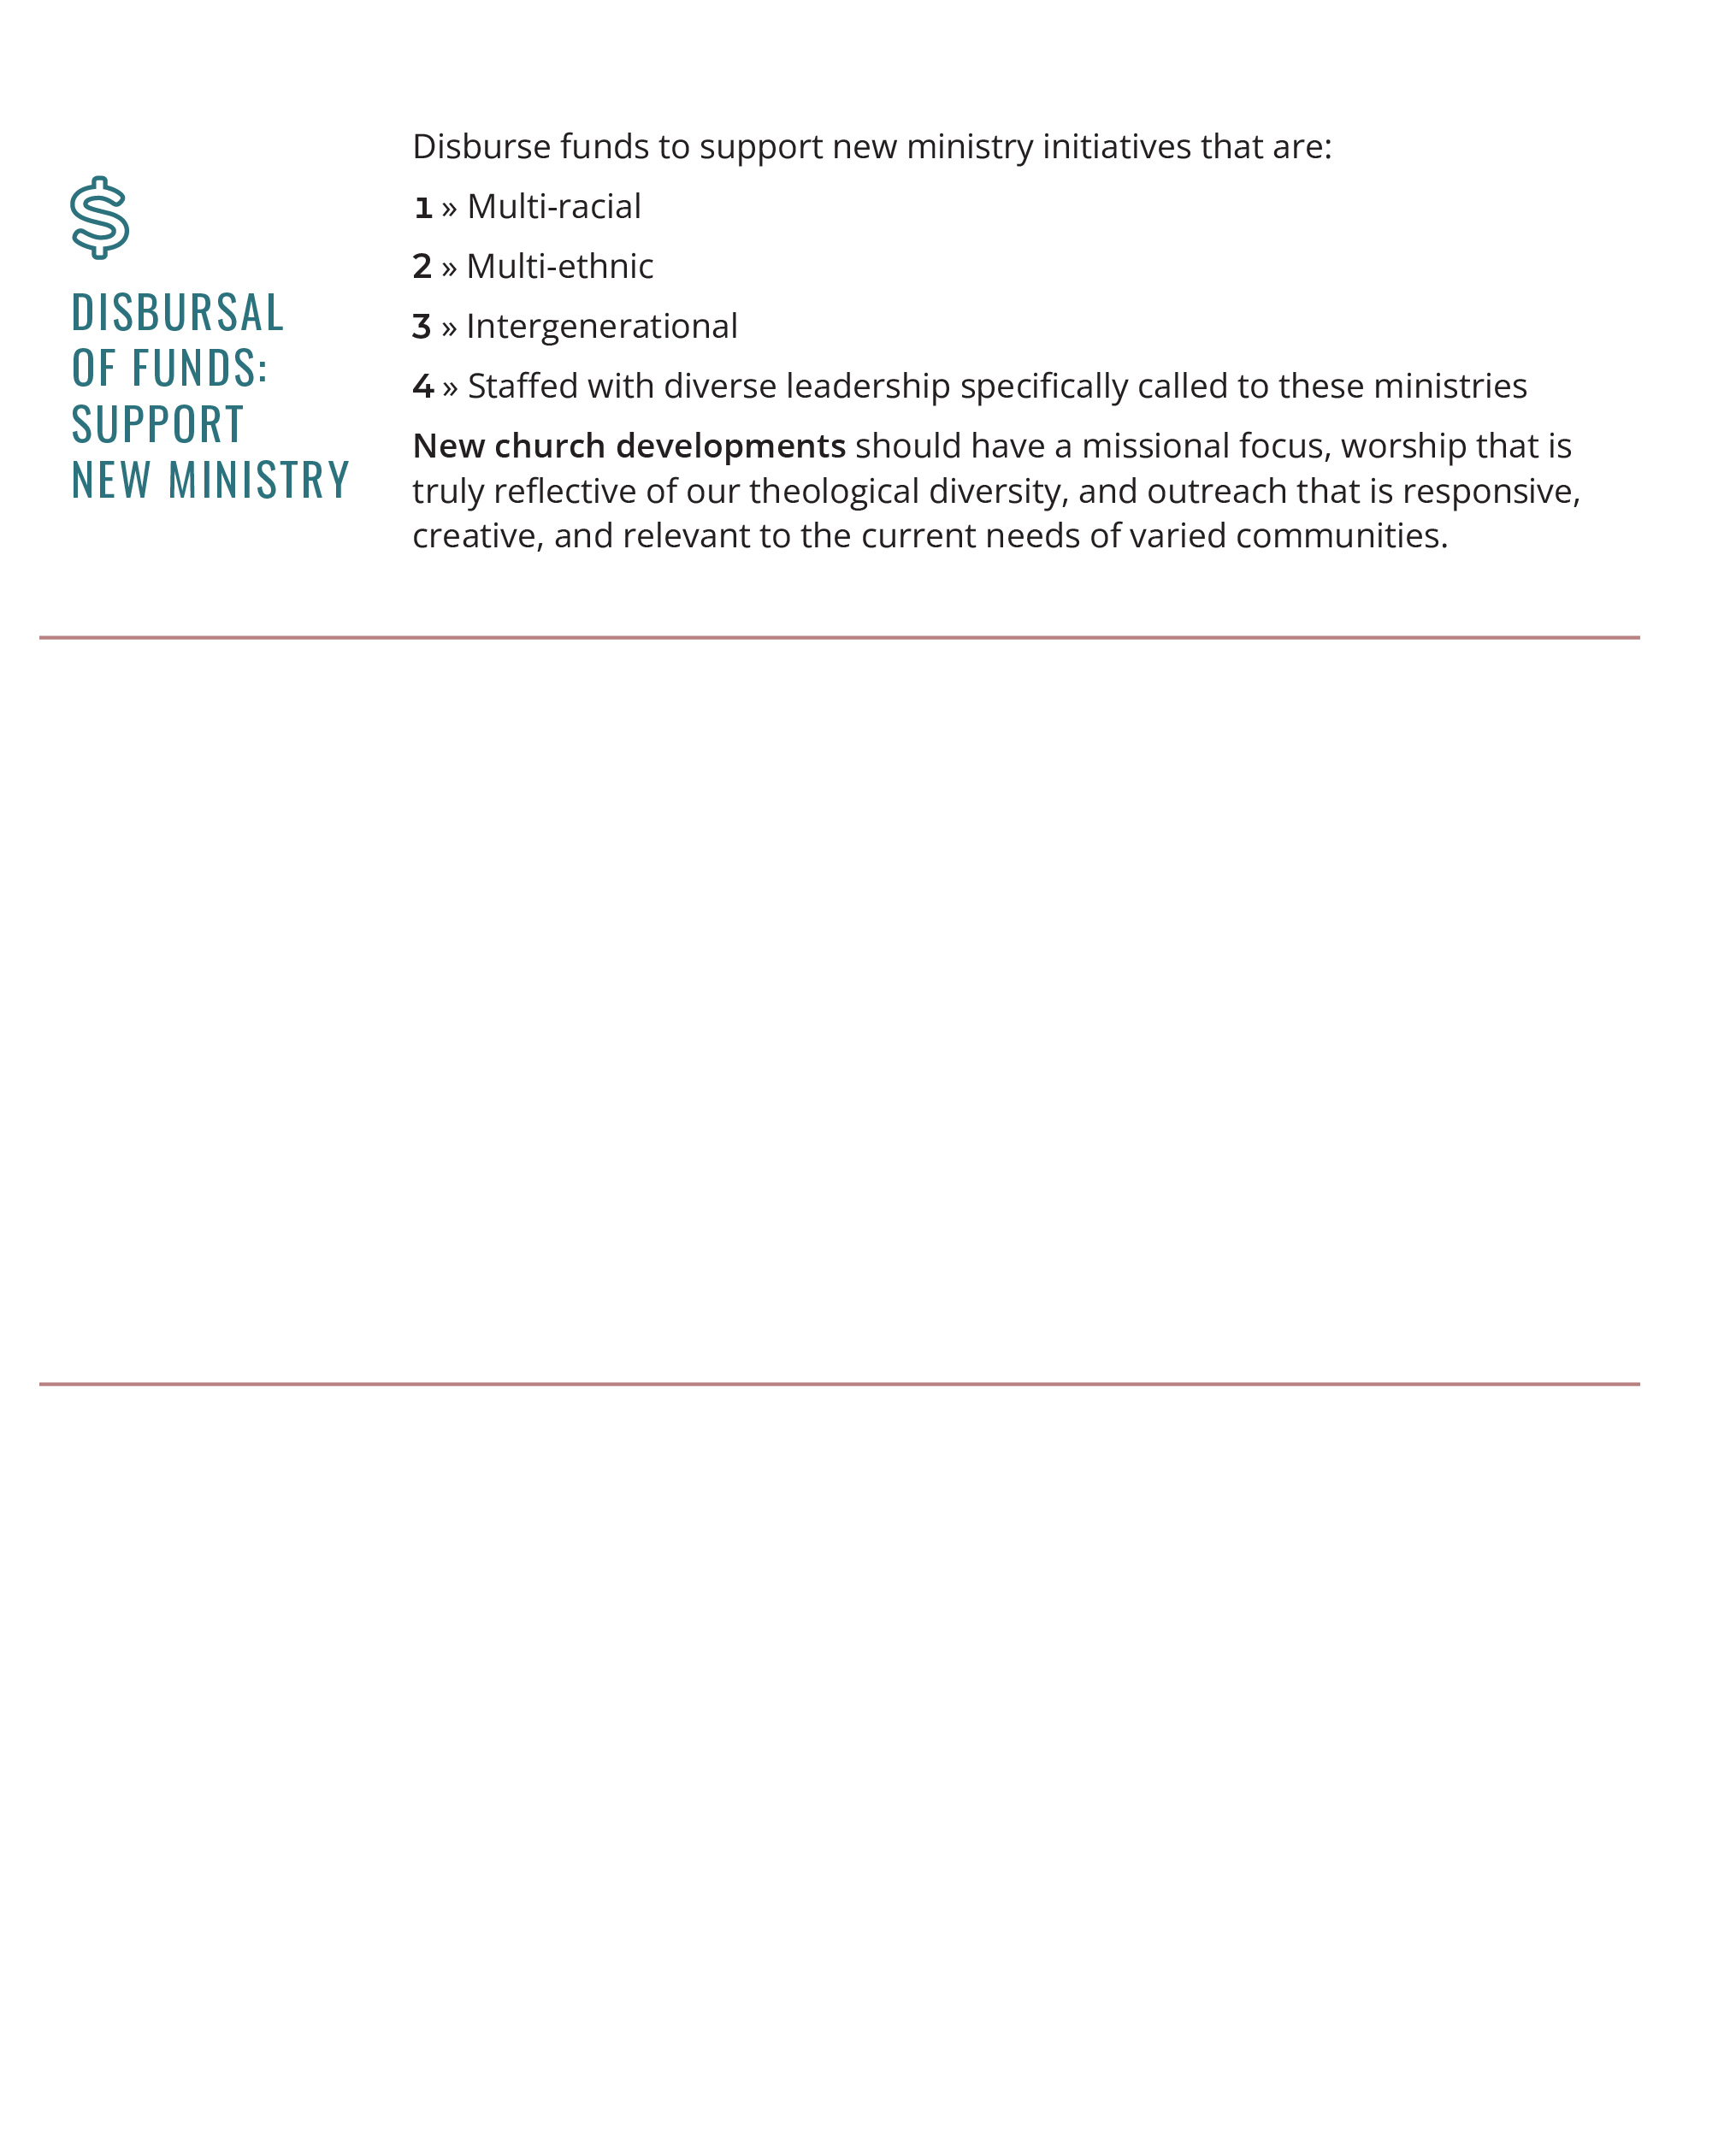

Slide 14
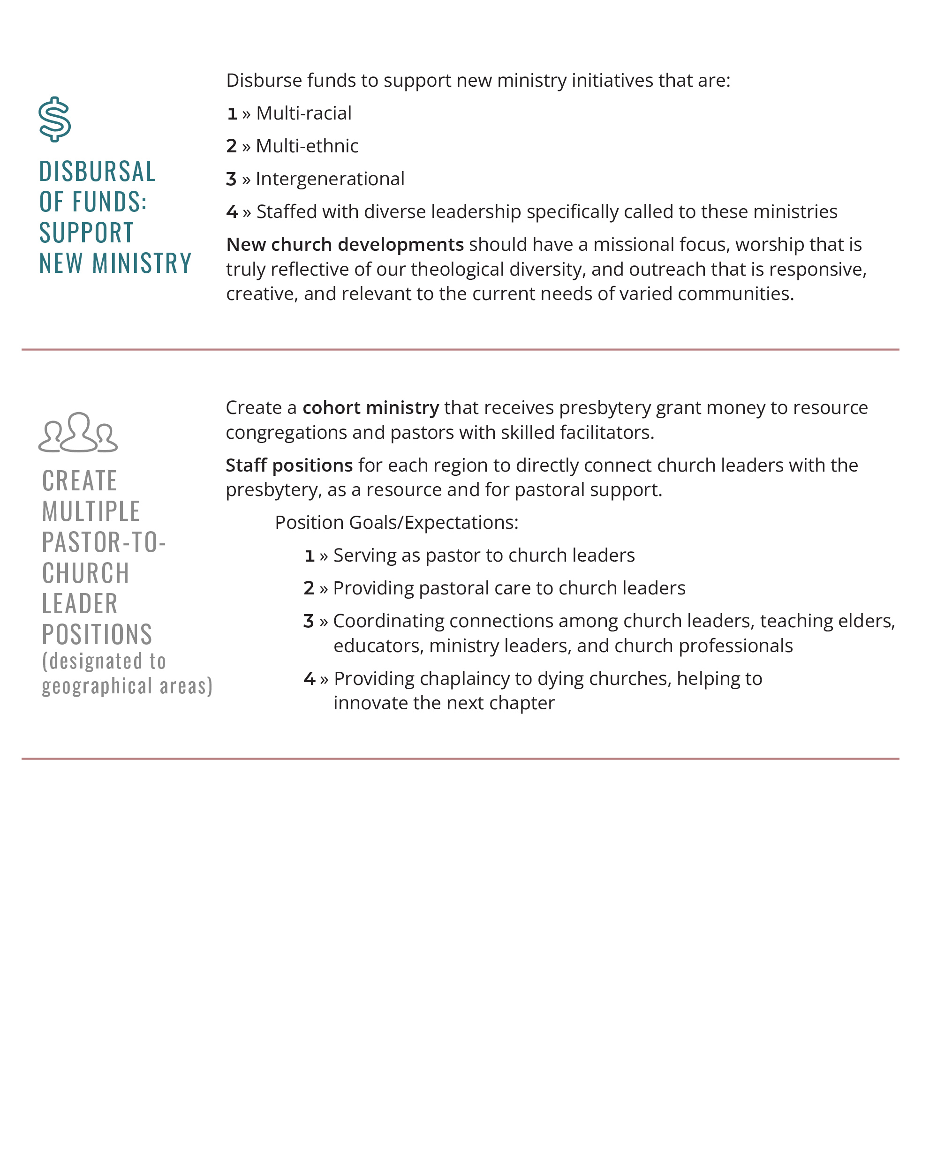

Slide 15
